Slide 1

WALMART SALES FORECASTING
Prepared By: SIDRA KAMAL

Slide 2
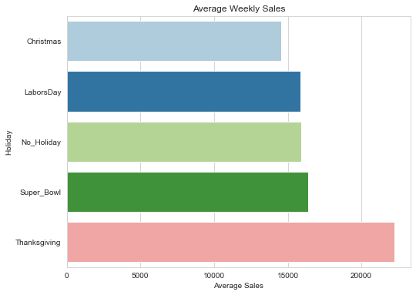

WHICH HOLIDAY HAS THE MOST WEEKLY SALES?

Slide 3
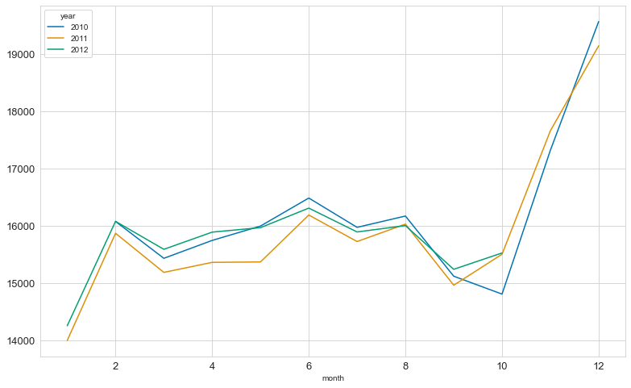
WHICH MONTH BROUGHT IN THE MOST WEEKLY SALES?

Slide 4

Which Store has the highest weekly sales?

Slide 5

Does Holiday or No Holiday bring in more Weekly Sales?

Slide 6

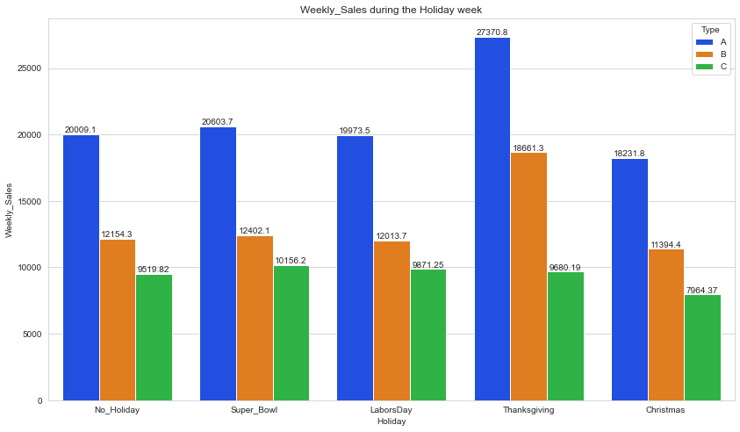
Thanksgiving, Christmas or Superbowl?

Slide 7

Temperature and Unemployment on Weekly Sales?

Slide 8
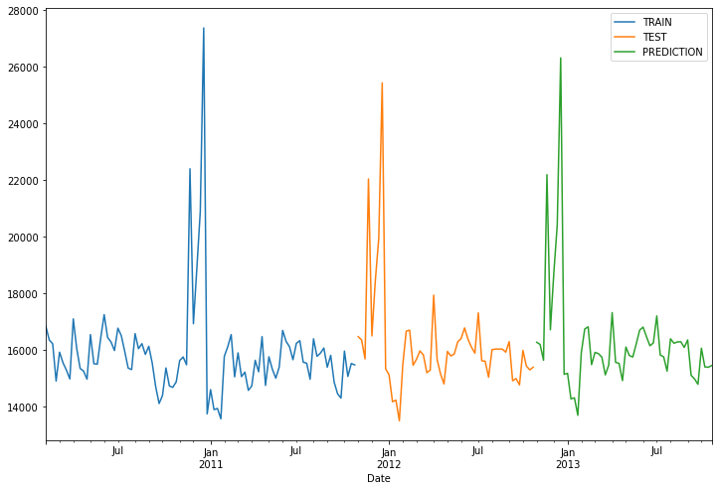
Data Modelling using SARIMA, AR, Holt Winters

Slide 9
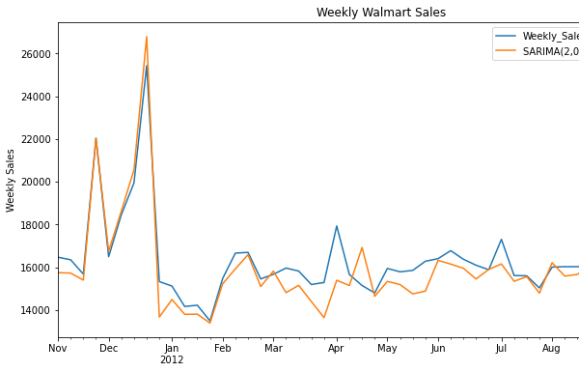
SARIMA

Slide 10
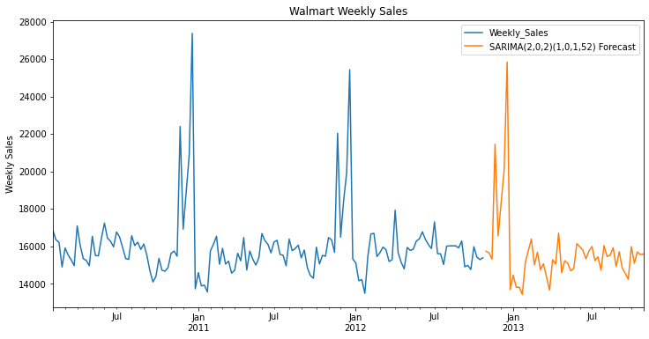
Sales Forecasting

